Slide 1
Edmonton Federation of Community Leagues
“Leagues Alive” Conference
Attracting and Retaining Volunteers
Presented by Amanda Sokol

Slide 2


Slide 3
What is a volunteer?
vol-un-teer
(noun)
A person who does work without getting
paid to do it

Slide 4
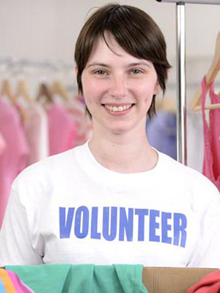
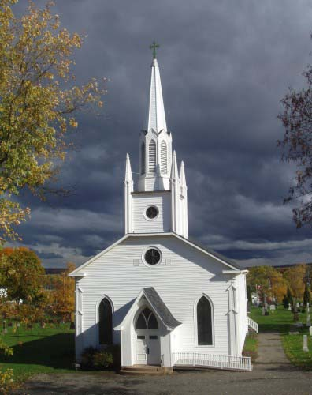

Statistics about volunteers in Alberta
Women volunteer more than men (58% vs. 51.6%) Women also volunteer more hours (142 vs. 137)
People who attend religious ceremonies volunteer more hours (243) than those who do not (114)
People with no children volunteer the most hours (151) compared to people with school aged children. Those with preschool aged kids volunteered the least (62 hours)

Slide 5
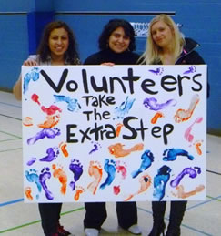
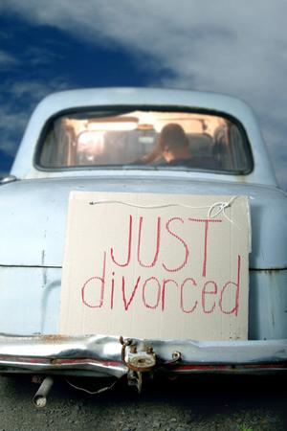

Statistics about volunteers in Canada
Volunteers aged 15-24 had highest volunteer rate (58%) 16-19 years olds (66%)
Youth gave fewest hours – seniors gave the most
Separated or divorced individuals volunteered 237 hours – 96 hours more than those who are married or common law!
In Canada, 13.3 million people over 15 volunteered in 2010
They gave 2.1 billion hours.

Slide 6

Barriers to volunteering
69% no extra time
46% too long of a commitment (year round)
38% give money instead
37% not personally asked
25% no interest
24% health problems
22% already volunteer enough
20% don’t know how
19% cost of volunteering
8% bad previous experience
7% legal concerns

Slide 7
Motivations for volunteering
95% believe in the cause
81% use skills or experience
69% you/someone you know affected by cause
57% explore own strengths
26% fulfill religious obligations or beliefs
23% improve job opportunities
8% required to

Slide 8

Planning for volunteers
Volunteer Role Descriptions: the backbone of a volunteer program!

Slide 9
Volunteer Role Description
Title of Volunteer Role: Something creative and eye catching but not ambiguous
Description of volunteer position: State the purpose and description of the positon
Key responsibilities: List all of the duties and tasks hat volunteer will perform
Time of commitment: How many hours, what time, duration of commitment
Dates required: Start and end dates
Qualifications: List all of them – include MUST have and nice to have
Best suited for: What kind of person would be successful in this role?
Supervisor: Who will this volunteer report to?
Resources, Training and Support required: What will volunteer need in order to complete tasks successfully?
Benefits to the volunteer: List all tangible and intangible benefits

Slide 10
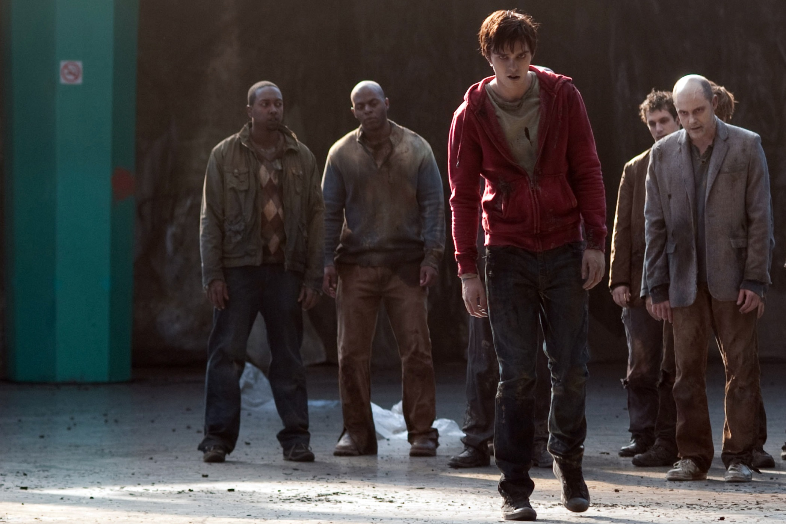
Recruiting volunteers
…are we just looking for warm bodies?

Slide 11
A targeted approach
Who would have the qualifications for this volunteer role?
Who would be best suited for this position?
Who would enjoy the benefits offered by volunteering for this role?

Slide 12
Type of volunteer | Where would you find them? | Best way to appeal to them? | Who best to promote the appeal?
Jr. or Sr. high school students
Post secondary students
Working individuals
Stay-at-home parents
Professionals
Active retirees
Seniors
Newcomers
Families
Groups

Slide 13

When recruiting, always focus on the volunteer, they want to know…

Slide 14



Slide 15

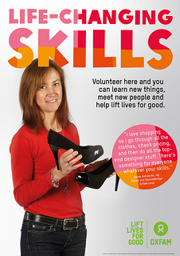

Slide 16


Slide 17


Slide 18
Places to post volunteer opportunities
Go Volunteer
Get Volunteering
SCiP Program (Volunteer Alberta)
U of A InfoLink
Linking Boomers
Goz Around
Action Generation
Visit www.volunteeredmonton.com for links to these sites.

Slide 19
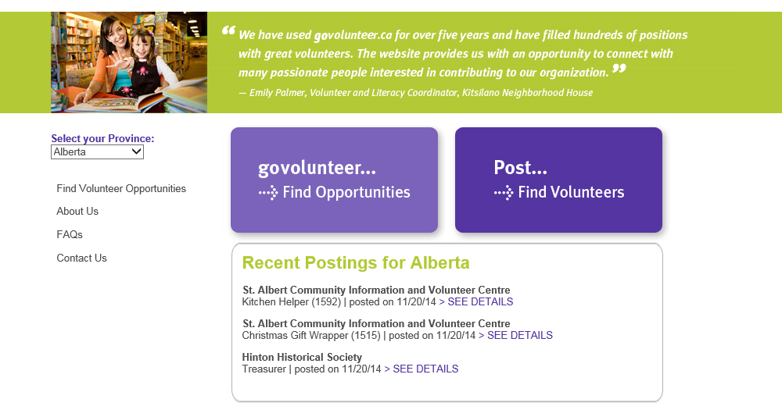

Slide 20
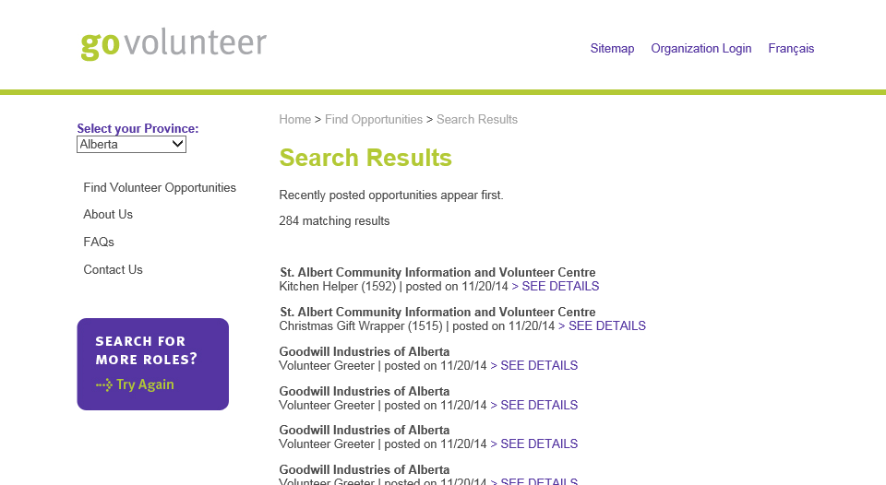

Slide 21
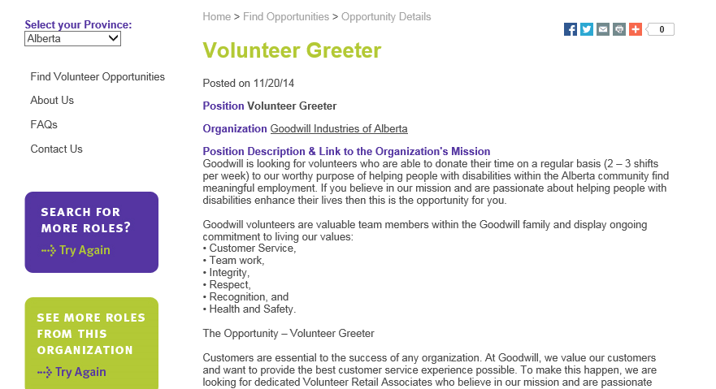

Slide 22
Off line places to find volunteers
Community newsletters
Recreation centres
Local businesses
Local schools
Print publications such as: Vue Weekly, Metro, Edmonton Examiner
Media spots on TV or radio
SHAW 10 Cable Crawl (Go! Edmonton)

Slide 23
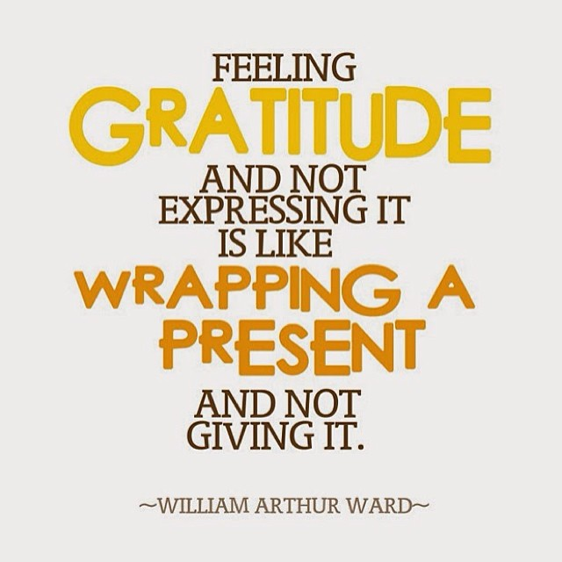
Recognizing volunteer’s contributions

Slide 24
Top two ways volunteers want to be recognized
• 80% stated that they would like to be recognized or thanked by the organization they volunteer for by hearing about how their work has made a difference.
• Close to 70% stated they would like to be recognized by being thanked in person on an ongoing, informal basis.
Least preferred ways volunteers want to be recognized
• Volunteers indicated that their least preferred forms of recognition include banquets, formal gatherings, and public acknowledgment in newspapers, radio or television. Interestingly, these methods are common methods for many organizations, with 60% citing banquets and formal gatherings, and 50% using public acknowledgement as their recognition strategies.

Slide 25

Volunteer Recognition
You must thank volunteers in a way that is meaningful for the volunteer!

Slide 26
Knowing motivation for volunteering helps you to thank volunteers in a meaningful way
Look at volunteer role description – what are the benefits listed? Who is best suited for the position?
Ask volunteers how they want to be thanked
Always let them know the impact of their contribution!

Slide 27
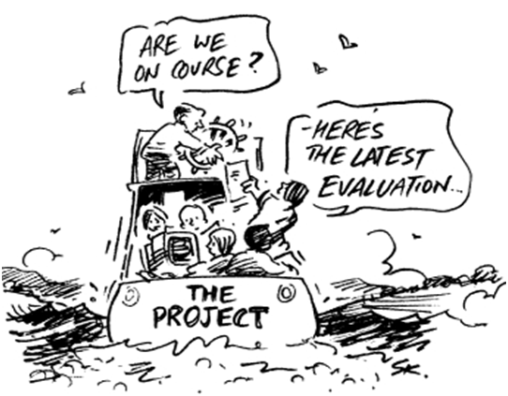
Evaluation

Slide 28
What do you want to know?
What will you ask?
How will you ask?
When will you ask?
What will you do with the information you gather?
Evaluate the volunteer program as well as individual performances.

Slide 29

Thank you for attending this session and for all that YOU do for Edmonton!
Amanda Sokol, Program Coordinator,
Volunteer Edmonton
asokol@volunteeredmonton.com
780 732 6649

