Slide 1
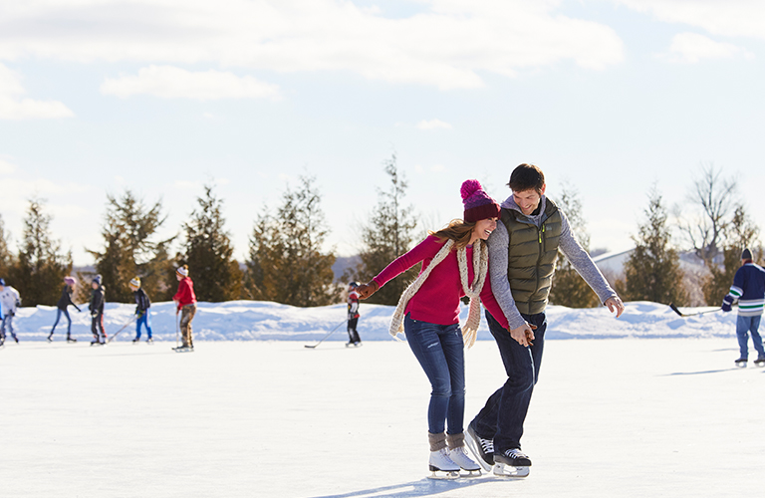
Recommended Risk Management & Safety Guidelines for Skating Rinks
* Rinks to be checked on a regular basis – particularly in adverse weather conditions when temperatures can drastically fluctuate
* Ice surface should be free of stones, other debris and hazards (e.g.: cracks or frost boils)
* Fresh snow should be cleared to ensure safe, even surface conditions
* There should be ample lighting around the rink for night skating
* Outdoor rink/ice thickness is recommended at 2 to 2.5 inches
* Rink boards (including pop-up snowbank rinks) to be installed properly without protruding stakes or other materials
Permanent signage should be posted in a location easily visible from the rink, including information such as:
o Hours of Operation
o Rules of Conduct
o Alcohol Prohibited
o Helmets and Safety Gear is strongly recommended for all skaters
o Children should be actively supervised by a responsible person/adult
o Use of cell phones and/or headphones while on the ice is not recommended
o Carrying an infant on the ice is not recommended
o Skaters should skate at a safe speed – faster skaters to the outside of the rink with slower skaters closer to the middle
o No loitering along rink boards
o Skating in a manner that endangers or interferes with other skater’s safety or pleasure is strictly forbidden. Individuals displaying unsafe or inappropriate behaviour on or off the ice will be asked to leave
o No fighting, pushing, checking, foul language, smoking, spitting or high sticking
o The Community League reserves the right to revoke privileges from any person who does not follow rules, shows unacceptable conduct, or for any other just cause
o Community League assumes no responsibility for the actions of individual and/or group users
o Skaters use rink at your own risk
* The above guidelines are recommended “best practices” for all Edmonton & Area Community Leagues

